Slide 1
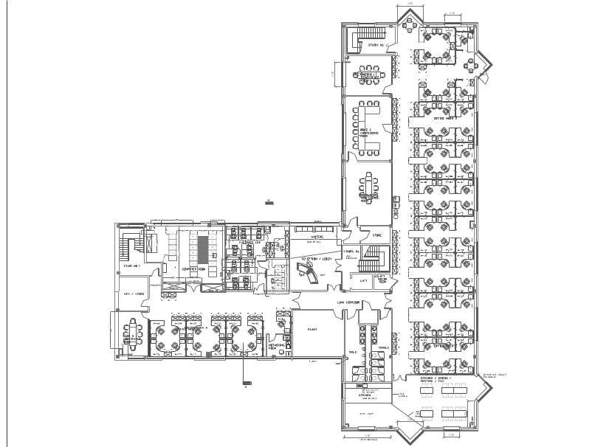
Brookvale Plaza
Conference Room Locator
Walton
Clancy
Boole
Boyle
You are here

